Slide 1

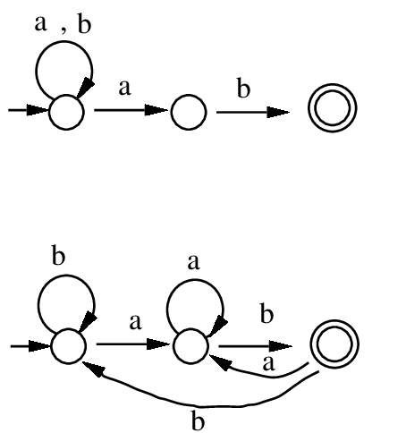


NFA to DFA

Slide 2

NFA to DFA
Theorem 1: Let “L”be a language accepted by a NFA. Then there exist a DFA that accepts “L”
3

Slide 3
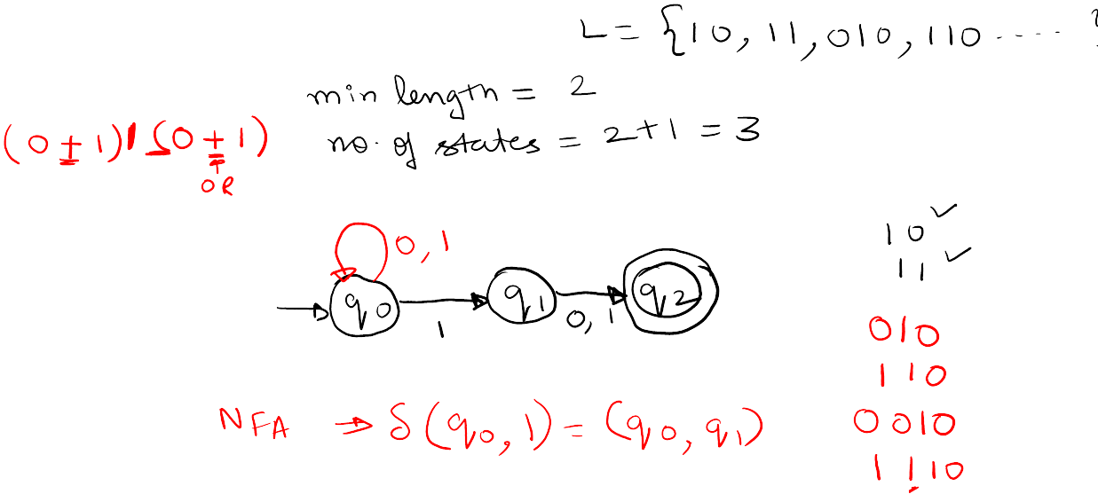
Example of NFA
Q. Design NFA with Σ={0,1} accepts the strings in which second last bit is 1
3

Slide 4
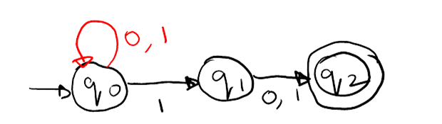
NFA to DFA
3

Slide 5
NFA to DFA
Step 1: Construct NFA transition table from given data
Step 2: New DFA transition table
Step 3: Construct DFA with the help of new table
3

Slide 6
NFA to DFA
3

Slide 7
NFA to DFA
3

Slide 8
NFA to DFA
3

